Slide 1
PhD purpose
Giacomo Ubaldi
1
Giacomo Ubaldi
Notes:
OK in this presentation i want to speak about in vivo monitoring of the dose or of the range in add on therapy what it is about the main methods and research and the first clinical
<numero>

Slide 2
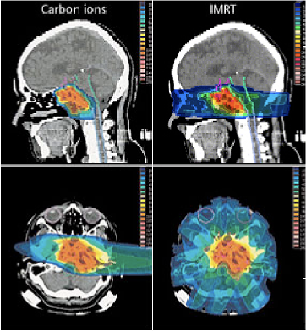
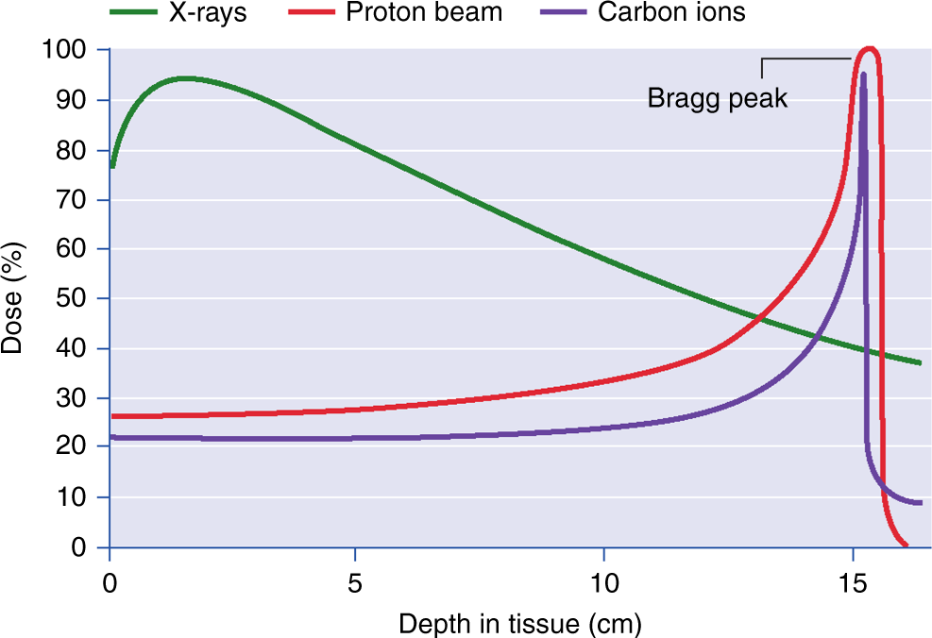
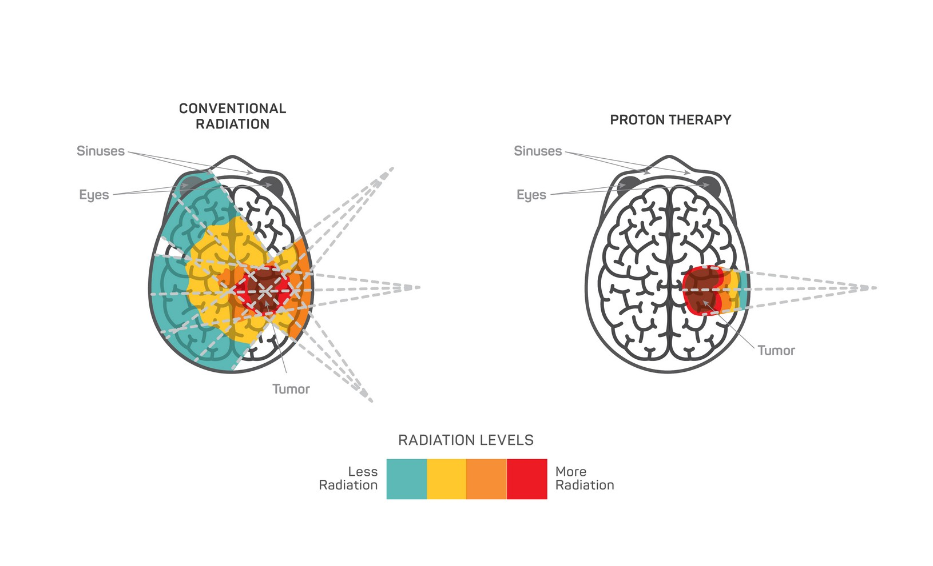
Hadrontherapy
tumor
Sketch of a treatment planning system on brain-located tumor
Hadrontherapy vs radiotherapy:
Finite range
Localized dose profile
Nuclear fragmentation
depth- dose profile for X-rays and charged particles as a beam
1
Notes:
Let's start from the beginning. Radiation therapy represents a way to exploit an external beam of radiation, which delivers energy, or those in a specific region of the human body where there is a tumour in order. To kill the tumour cells, or to limit their proliferation. He, according to the kind of radiation in the beam, the delivery of those is different. Let's consider now the dozer profile. So there is of those in terms of depth in the human body and what are the main differences between radiation therapy. Radiotherapy, the most common one which exploits the X rays and add on therapy. The most promising one which uses charged particles. What we can see is that for add on therapy we have a highest physical selectivity, which means that the highest release of those is a focused in a very specific region. Very close to the range. A end of the charged particle and it is called Brad Pick. So according to the energy given to the BMA, it is possible to have a black pika in the specific region of the tumour. We can say. So add on therapy. Can be two favourable with reference to radiotherapy becausr it's hayastan steepest gradient of those releasing just a region makes the highest spare of entity issues before and after the two rural region. However there are also some limits to the best. Then potentiality of this technique, and they are the range uncertainties in the clinical application of my treatment. So after his planning, it is possible that there are some discrepancy in the range of my beam. There can be shift which means. Chiefs of the black Beak in the entity in the tissues of the human body. In particular, there would be another dozing of tissues after the tumour and then under dozing in the two rural region. The consequence of this are that it is possible. to even create damages of arctic issues more than one than the ones of
<numero>

Slide 3
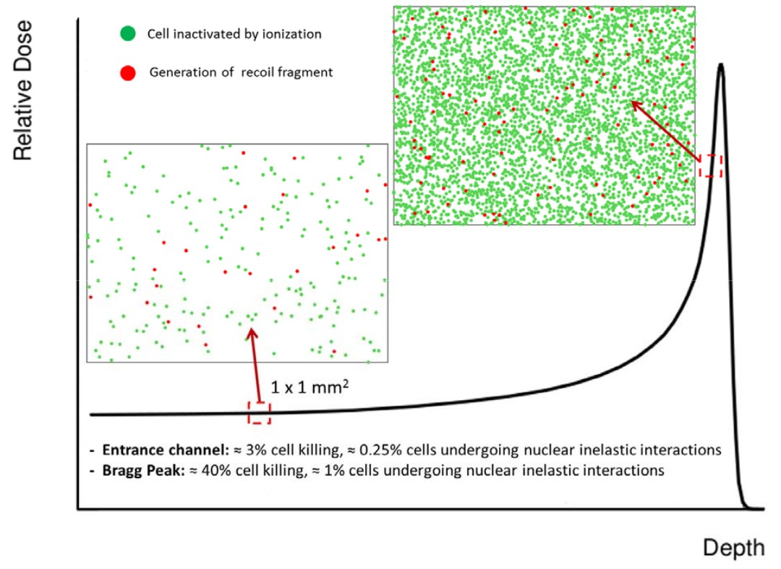
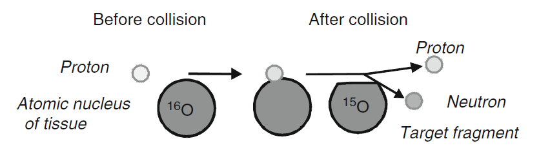
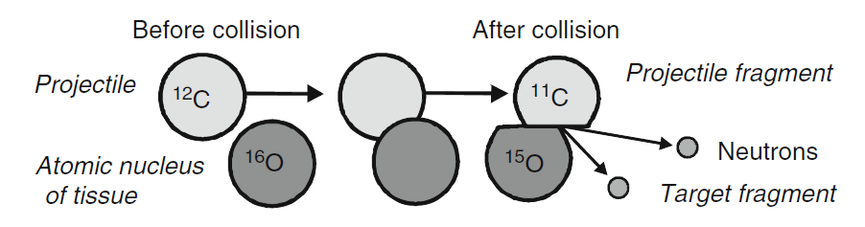
Nuclear Fragmentation
Proton beam:
~ 200 MeV
Damage in all the path
Carbon beam:
~ 400 MeV/u
Sketch of Nuclear fragmentation
Damage after the BP
1

Slide 4
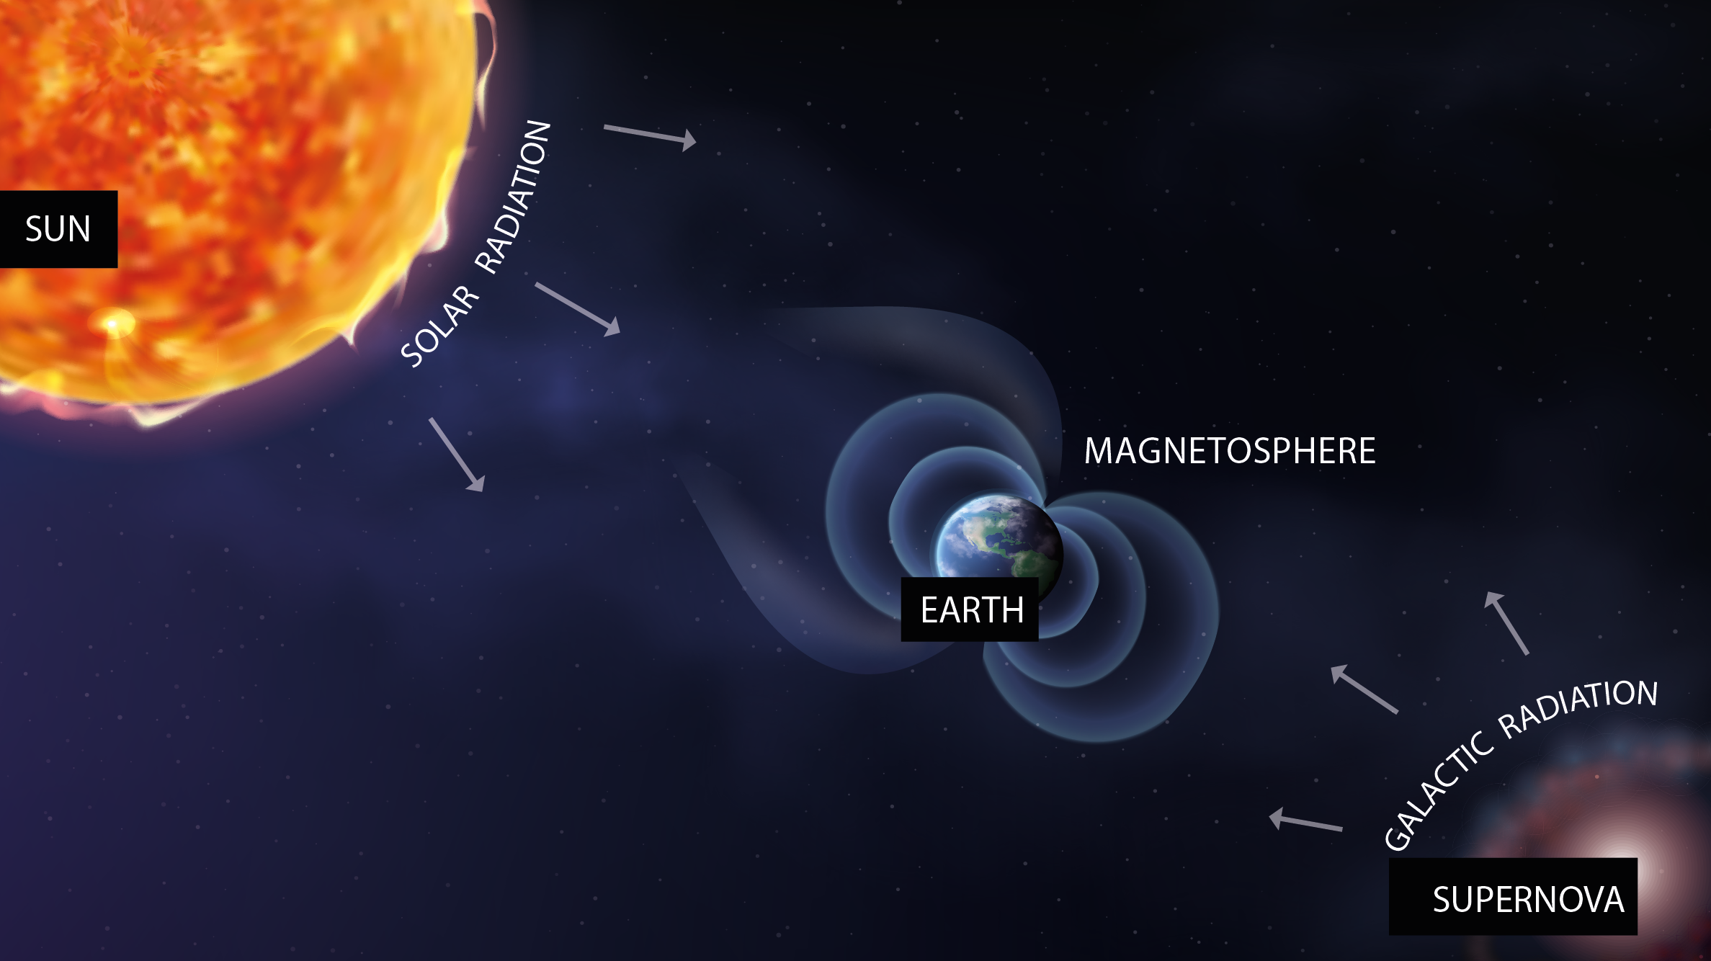
Space radioprotection
1

Slide 5
Space radioprotection
SOLAR RADIATION
suddenly
92% p
6% He
2% HZE
E<1 GeV/n
1

Slide 6
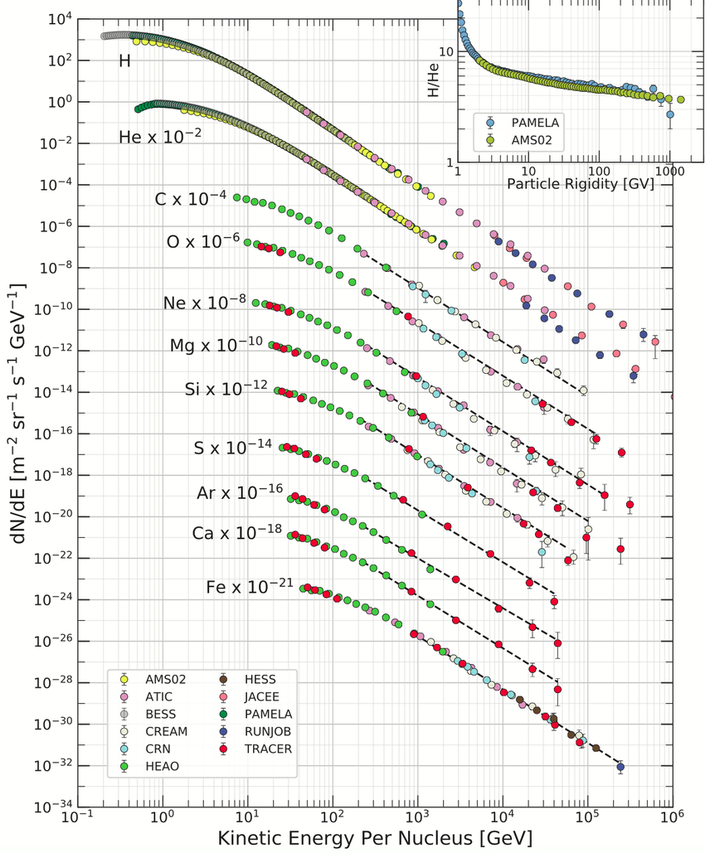
Space radioprotection
COSMIC RAYS
constantly
90% p
9% He
1% HZE
0.001 < E < 10¹⁴ GeV/n
1

Slide 7
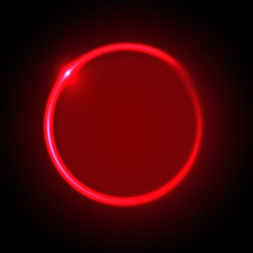




Space radioprotection
MARS
1

Slide 8
Space radioprotection
MARS
fragmentation
Effects on:
Space craft hull and structure
Shielding
Astronaut’s body
1

Slide 9
Space radioprotection
MARS
fragmentation
Dose equivalent
Dose
Fluence
1

Slide 10


The FOOT experiment
FOOT (FragmentatiOn Of Target)
measure double differential cross sections in angle and kinetic energy with a maximum uncertainty of 5%
Energies between 200 MeV/u and 700 MeV/u for hadrontherapy and space radioprotection applications
isotopic identification by measuring all kinematic quantities
table top setup to be moved according to beam availability
1

Slide 11
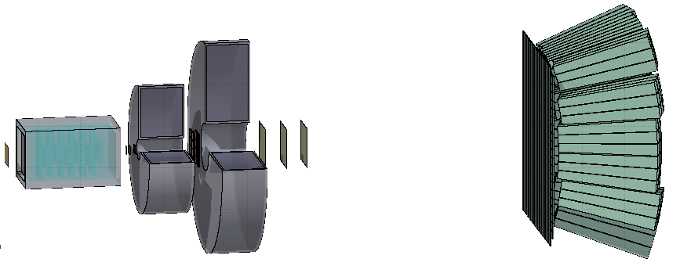
The FOOT detector
BEAM
z
1

Slide 12
The FOOT detector
Target
Start
Counter
Beam
monitor
BEAM
z
Pre-target region
<numero>

Slide 13
The FOOT detector
Target
Permament
Magnets
BEAM
z
Vertex
Tracker
Inner
Tracker
Microstrip Silicon
Detector
Tracking region
<numero>

Slide 14
The FOOT detector
Calorimeter
BEAM
z
ToF Wall
Downstream region
<numero>

Slide 15
The FOOT detector
Calorimeter
Target
Permament
Magnets
Start
Counter
Beam
monitor
BEAM
z
Vertex
Tracker
Inner
Tracker
Microstrip Silicon
Detector
ToF Wall
Pre-target region
Tracking region
Downstream region
<numero>

Slide 16
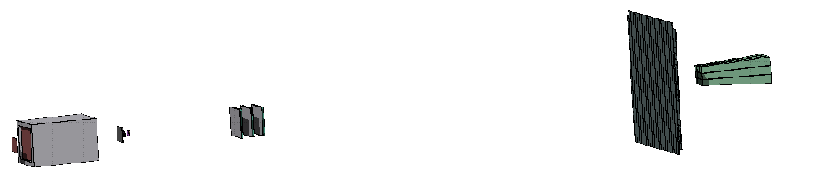
GSI 2021 analysis
Analysis on MC and real Data of ¹⁶O 400 MeV/u on 5 mm C target
taken at GSI (Dollmstadt) in 2021
Partial setup:
TW
MSD
BM
VTX
SC
CALO
TG
No B field → no p information, so no mass reconstruction possible
Only one matrix of calorimeter → limited kinetic energy information
First preliminary goal: charge changing angular differential cross section
<numero>

Slide 17
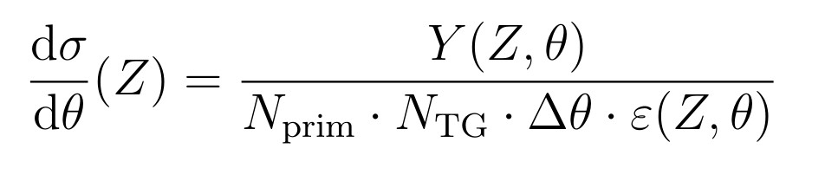
Differential Cross section
<numero>

Slide 18
Differential Cross section
N° of primary
events
N° of scattered
centers
<numero>

Slide 19
Differential Cross section
N° of primary
events
N° of scattered
centers
Phase space
<numero>

Slide 20
Differential Cross section
efficiency
N° of primary
events
N° of scattered
centers
Phase space
<numero>

Slide 21
Differential Cross section
Yield of all fragments
efficiency
N° of primary
events
N° of scattered
centers
Phase space
<numero>

Slide 22
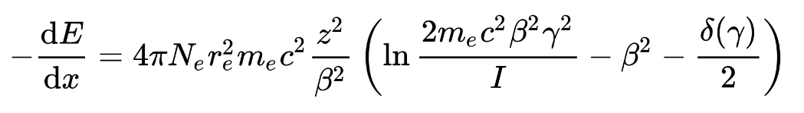
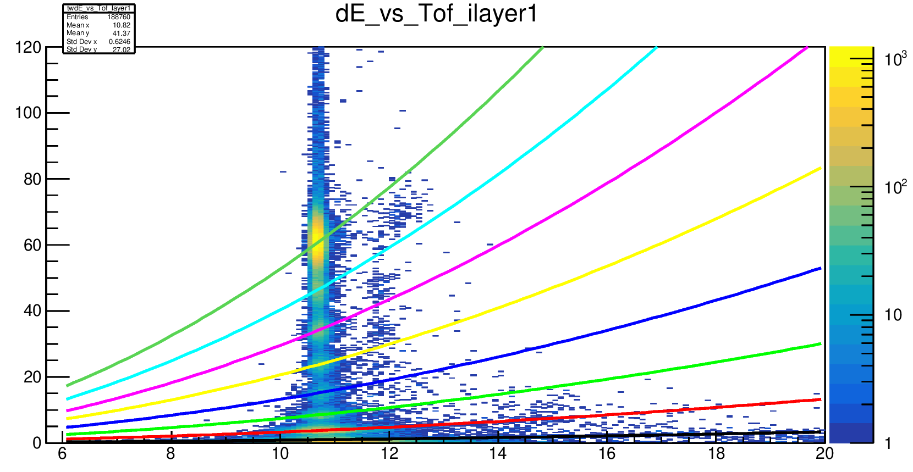
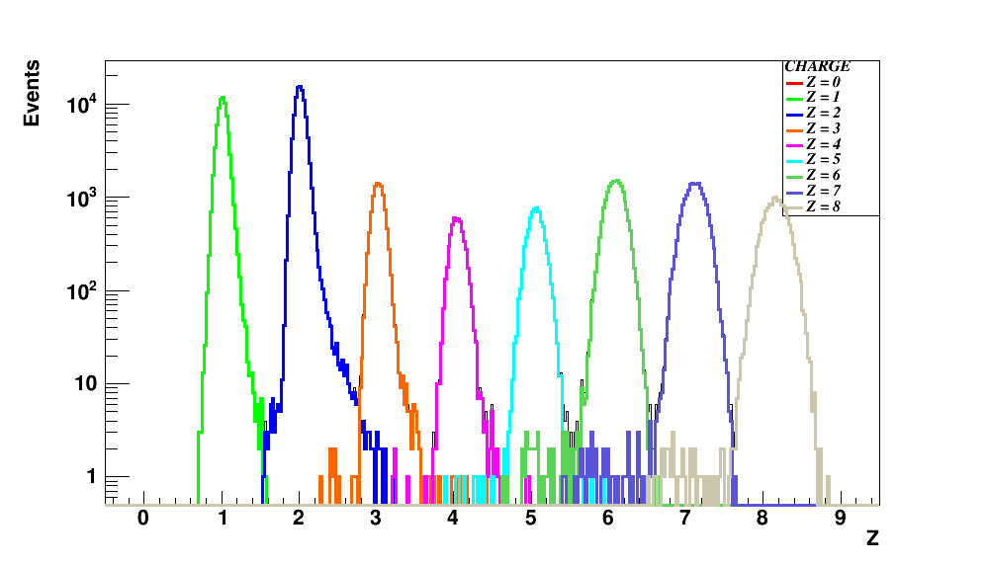
Fragments identification
From Bethe – Bloch formula I can get z:
Infos taken from SC and TW
dE
z=8
z=7
z=6
Histo con z interi,
Perché il TW usa algo specifico
z=5
z=4
z=3
z=2
z=1
ToF
<numero>

Slide 23
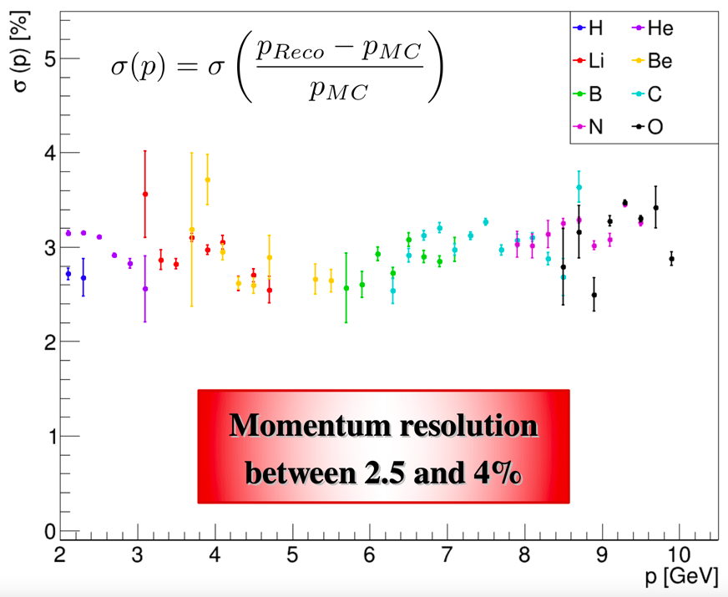
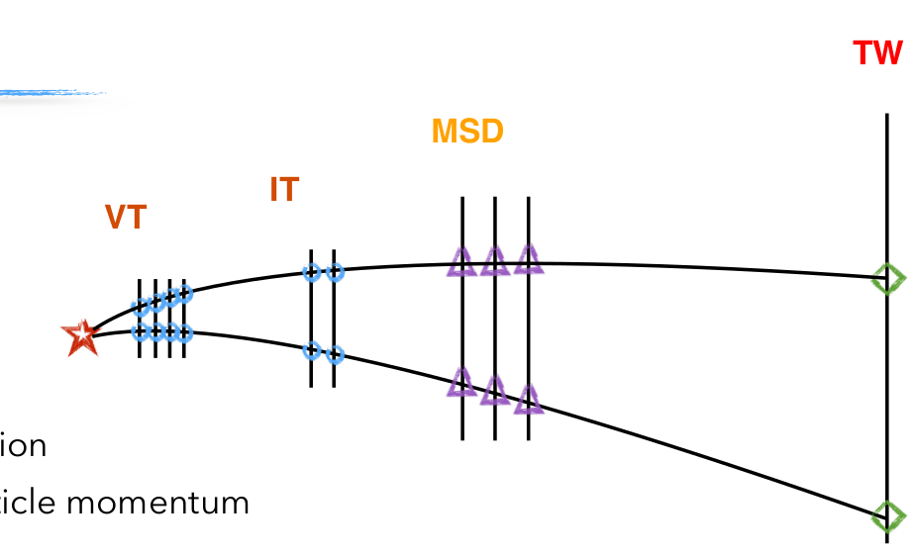
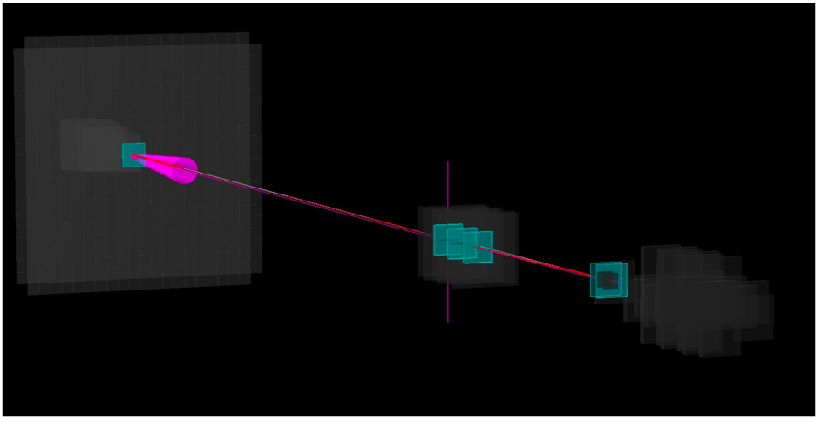
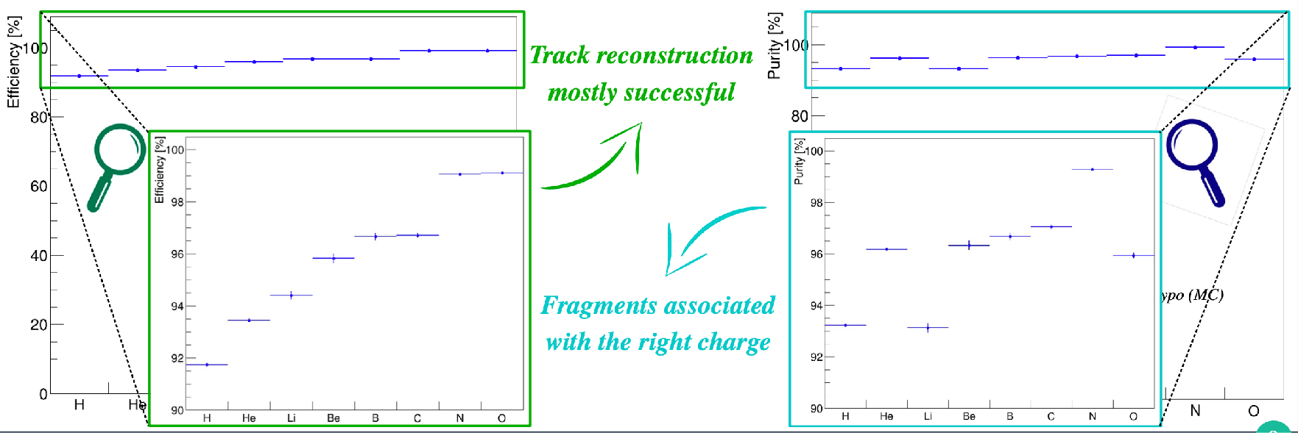
Track reconstruction
TW
MSD
VT
Kalman Filter reconstruction of a track
Start from VT tracklets
Projection to possible planes of IT
KF extrapolation to MSD
KF extrapolation to TW
Fit the track candidates and extract reconstructed quantities: Z, momentum ...
Simulation of track reconstruction on GSI 2021 data
No B field present
<numero>

Slide 24
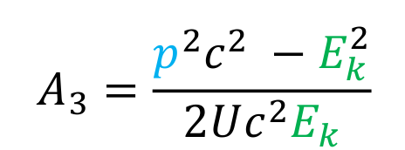
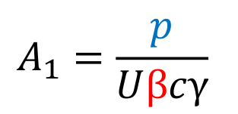
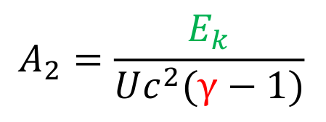
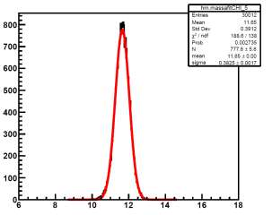
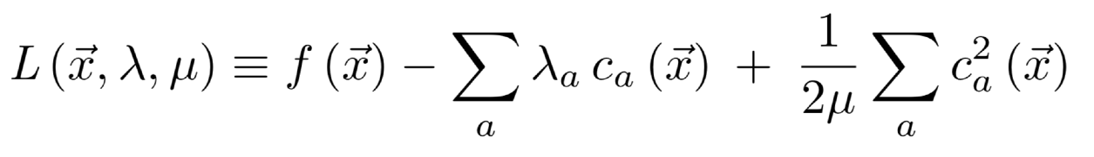
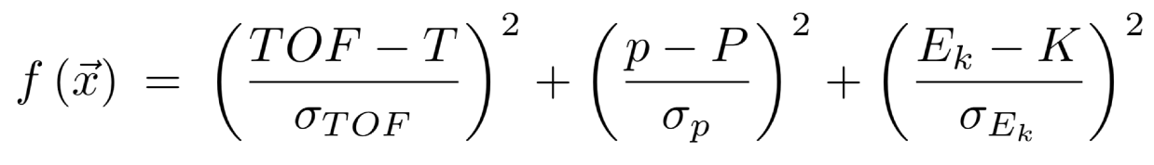
Isotopes identification
Mass reconstruction using all FOOT subdetectors:
In our data no tracker and calorimeter → mass measurement only in MC data!
Augmented Lagrangian Method
Aχ 2 = 11.66 ± 0.38
risoluz. 3.2 %
χ 2 < 5
<numero>

Slide 25
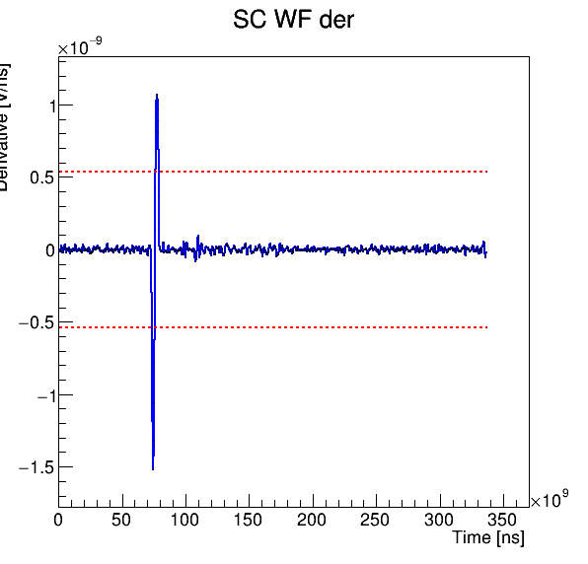
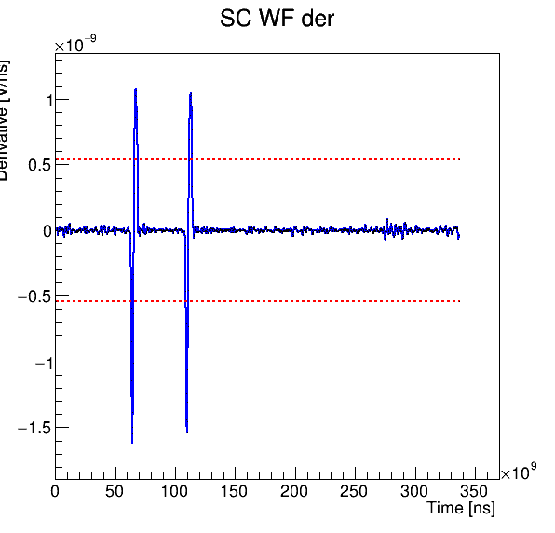
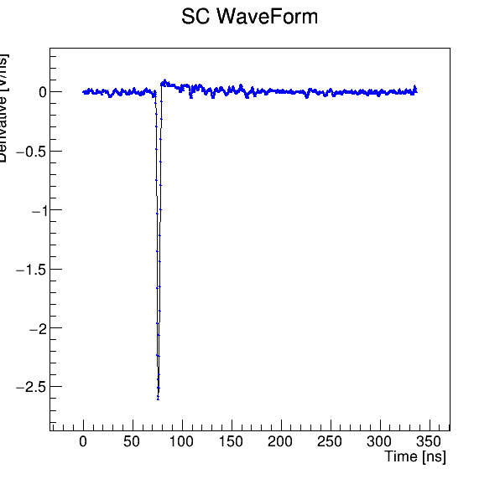
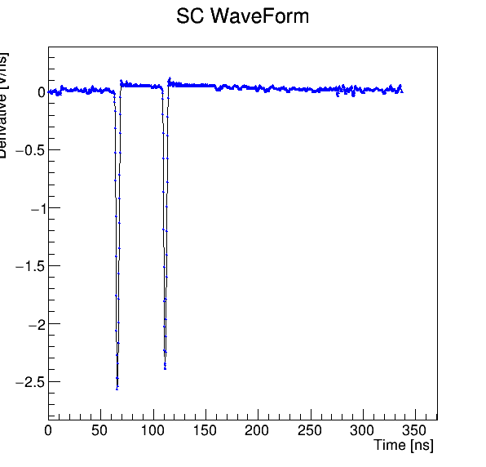
Pile-up removal
What it was seen in the last data taking (GSI - CNAO 2021) is that the beam flux is not constant → pile-up events
2 crosses
4 crosses
constant
threshold
discrimination
method
2 crosses
4 crosses
Single projectile
Pileup projectile
Single projectile: 4 crosses
pileup projectile: >4 crosses
<numero>

Slide 26
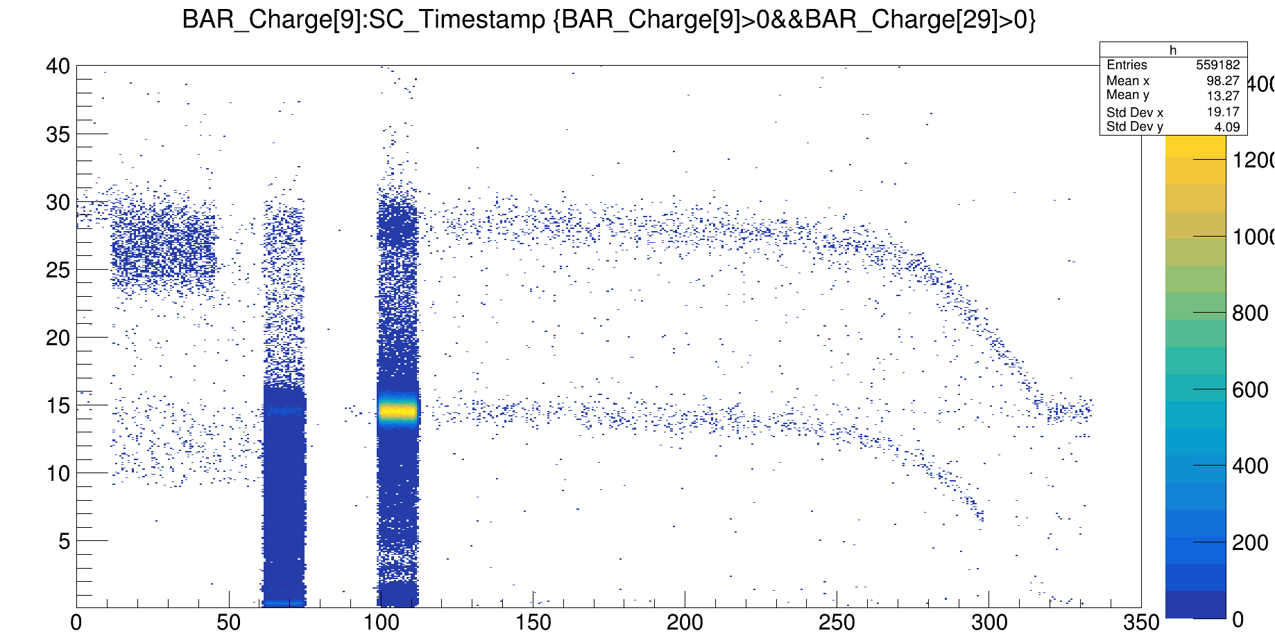
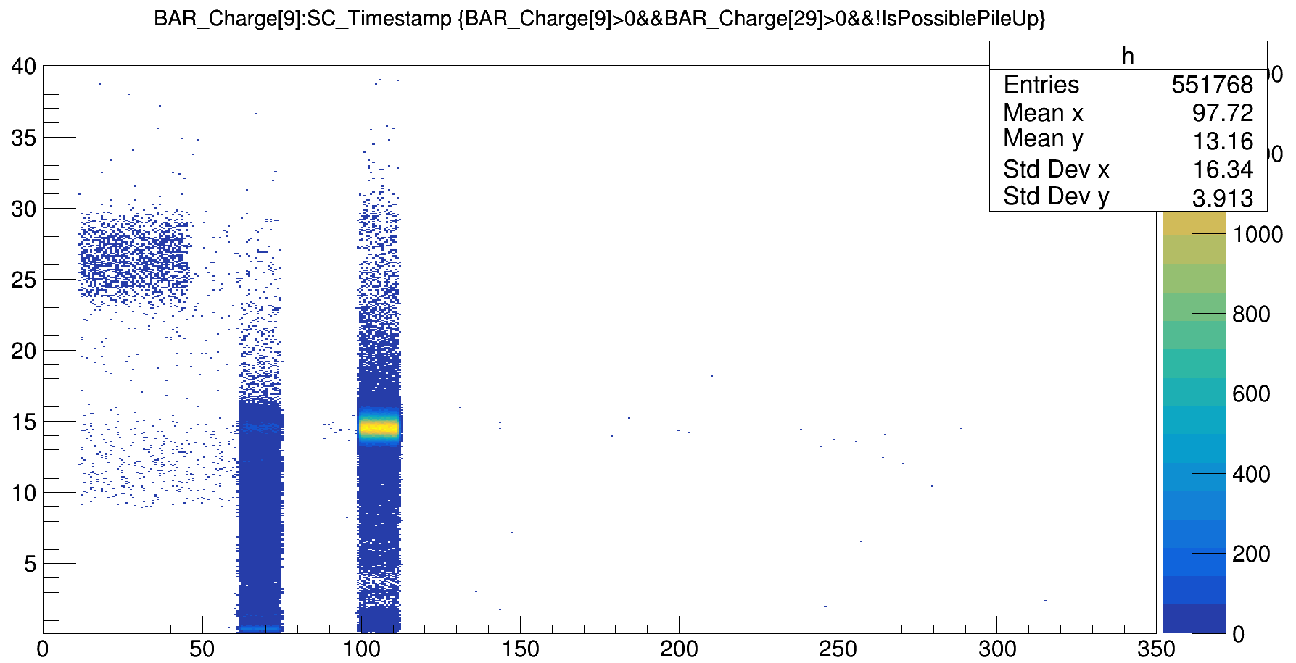
Pile-up removal
DataGSI2021/data_test.00004310.physics_foot.daq.RAW._lb0000._FOOT-RCD._0001.data
Both minimum bias trigger and trigger fragmentation
Charge
t(ns)
PileUp on 600.000 events ~ 1%
<numero>

Slide 27
Bibliography:
Review:
Proton thepary physics, cap 16 (In Vivo Dose Verification - Katia Parodi )
In vivo proton range verification: a review, Antje-Christin Knopf and Antony Lomax 2013
In vivo range verification in particle therapy - Katia Parodi
In-vivo PET:
Online Irradiation Control by Means of PET, Chapter 31- Fine Fiedler, Daniela Kunath
The INSIDE Project: Innovative Solutions for In-Beam Dosimetry in Hadrontherapy, Marafini, Battistoni
Detection of Interfractional Morphological Changes in Proton Therapy: A Simulation and In Vivo Study With the INSIDE In-Beam PET
Prompt gamma monitoring:
First clinical application of a prompt gamma based in vivo proton range verification system, Christian Richter
Charged particles monitoring:
Design of a new tracking device for on-line beam range monitor in carbon therapy, Traini
Inter‑fractional monitoring of 12 C ions treatments: results from a clinical trial at the CNAO facility, Fischetti

Slide 28
Back up slides
<numero>

Slide 29
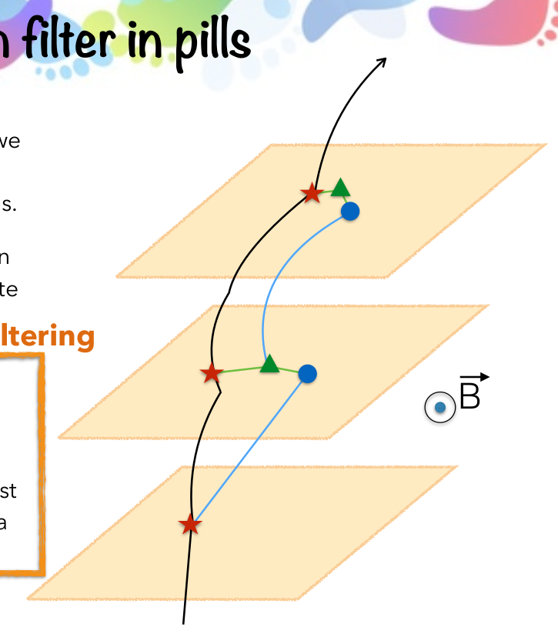
Kalman filter in pills
1. Take an ideal particle in vacuum. If we
add air + detector layers, trajectory
changes due to M.S. and energy loss.
2. We’ll see some measurement hits on
the detector layers (considering finite
detector uncertainty).
Filtering
3. Propagate the first hit to the next
layer. Propagator Matrix F.
4. Find the best compromise between
the propagated point and the closest
hit on the 2 nd layer. Use a Chi2 and a
Projection Matrix H.
5. Iterate 3 and 4 for the next layers.
<numero>

Slide 30
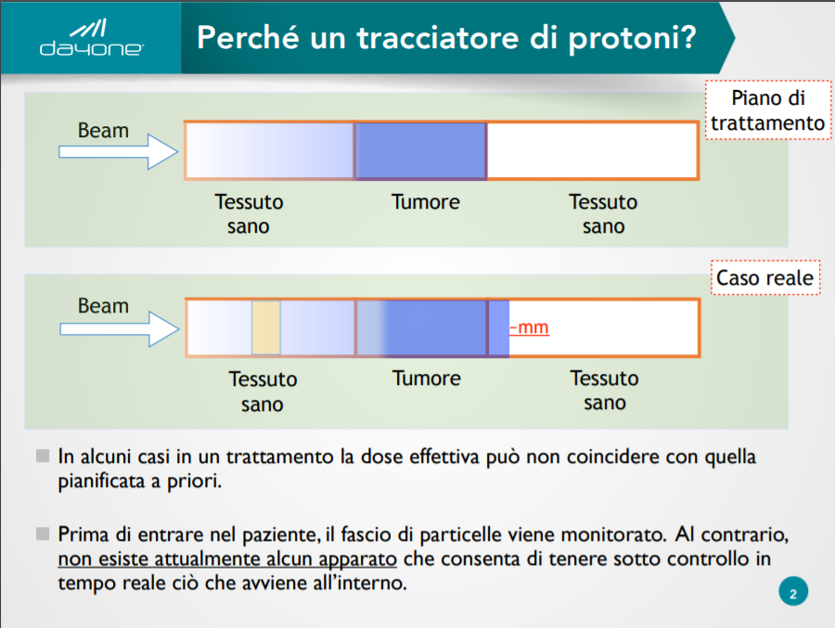

Slide 31
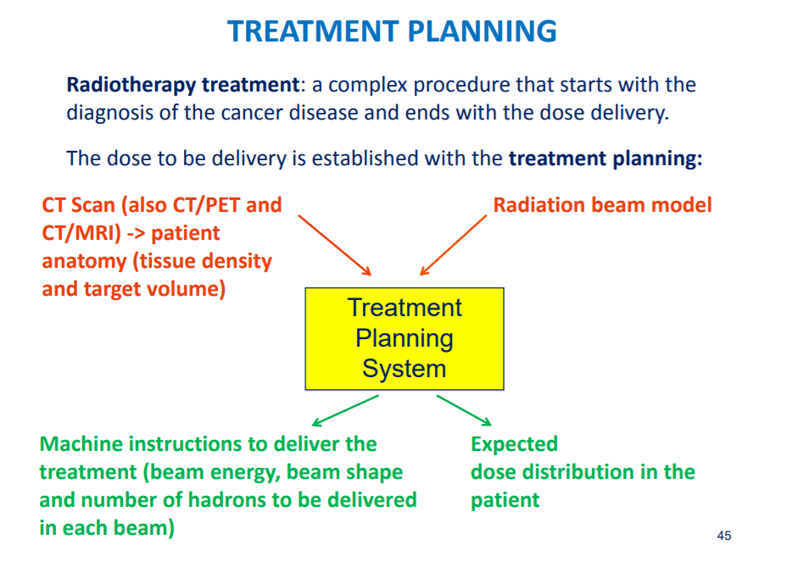

Slide 32
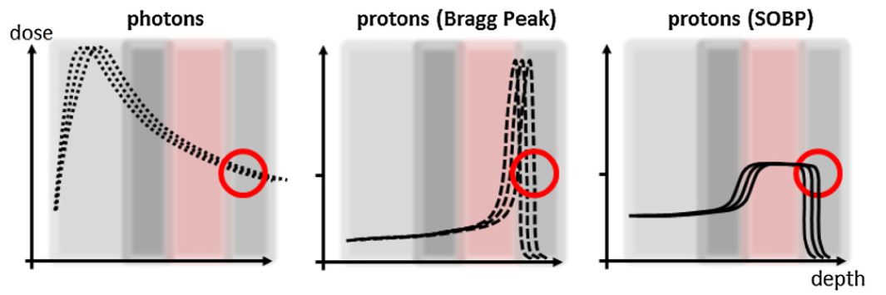
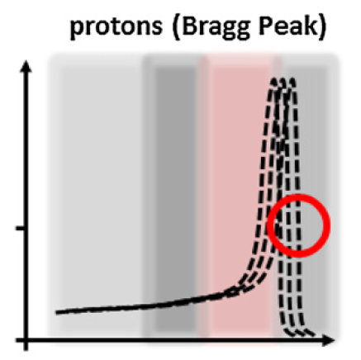
Effects of range uncertainties
Exponential attenuation risks:
little smear of the dose
+ range
uncertainties
tumor
depth
tumor
dose
Sharp gradient risks:
undershooting tumor
overdosing normal tissues
→ effects on proton
treatments
tumor
depth
<numero>
Notes:
<numero>

Slide 33
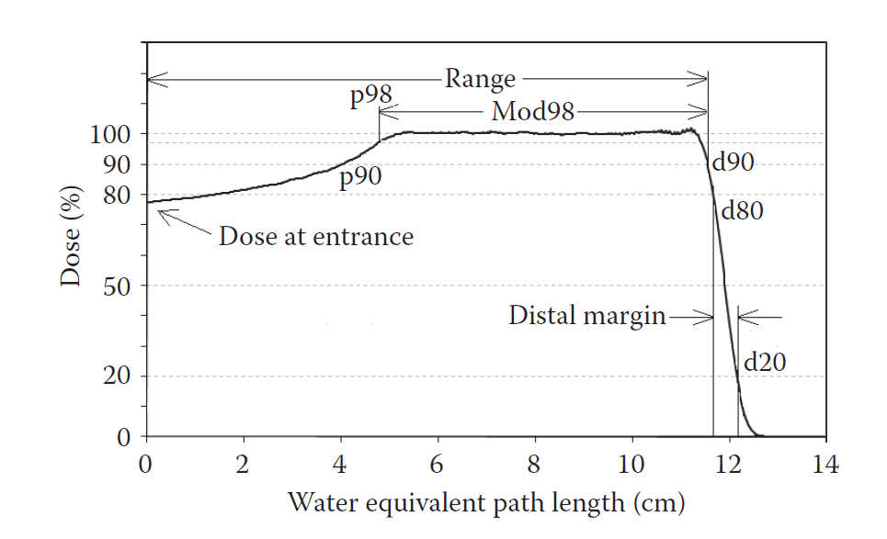
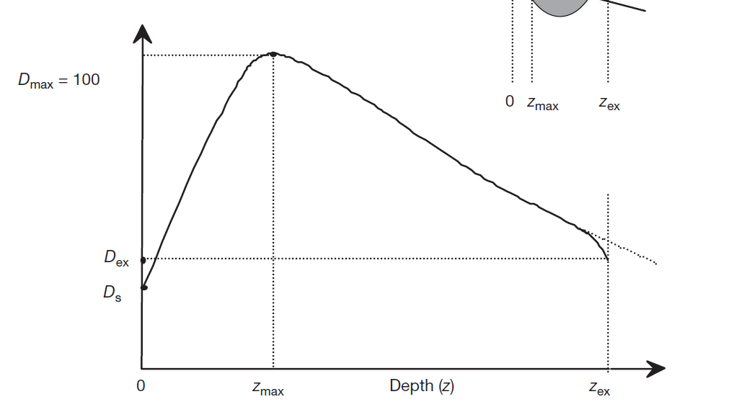
Beam specifications
dose
Sharp gradient risks:
undershooting tumor
overdosing normal tissues
+ range
uncertainties
dose
Dmax
Exponential attenuation risks:
little smear of the dose
Dexit
Ds
depth
depth
Specification of SOBP charged partice and X-ray depth–dose distribution in longitudinal size
Depth – dose distribution with range uncertainties
<numero>
Notes:
<numero>

Slide 34
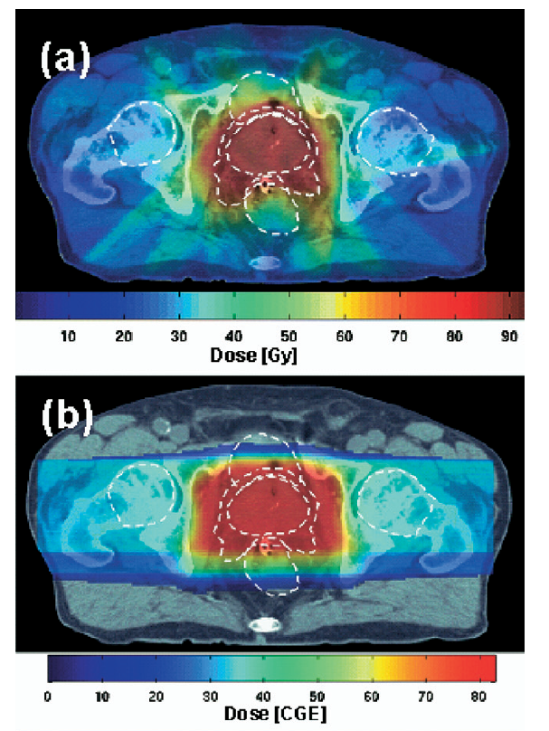
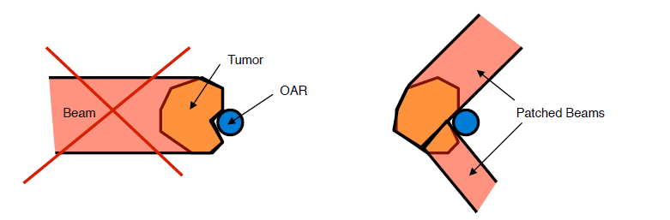
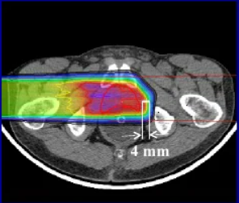
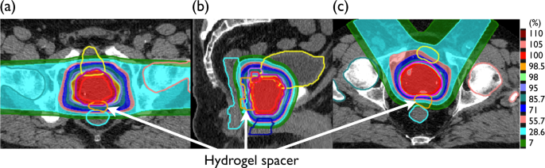
An example: prostate cancer
Safety margins ~ 4 mm
not possible to apply the optimal treatment
Patched beams
Example of Patched Beams application
Every mm is important
Must know and limit uncertainties
Planning treatment with conformal RT
Due to
too high
range
uncertainties
Planning treatment with PT – One Beam
Planning treatment with PT – Patched Beams
<numero>

Slide 35
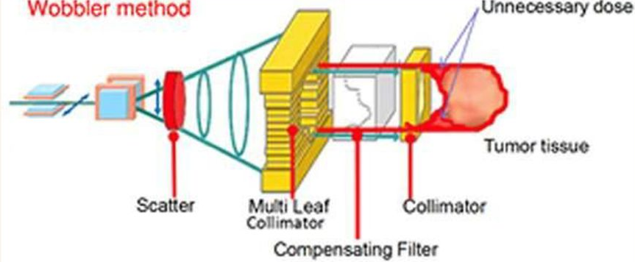
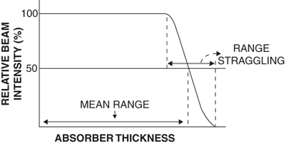
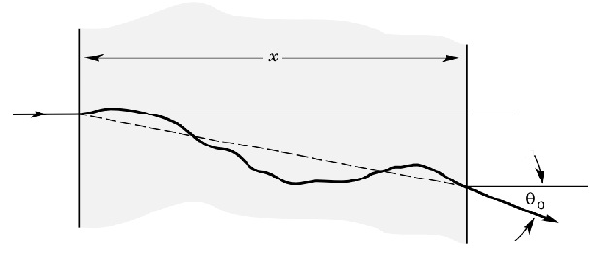
Sources of uncertainties
Physics related:
Range straggling
Formation of clinical proton beam
(random uncertainties)
Multiple scattering of the beam with absorbers
Range straggling
Multiple scattering
<numero>

Slide 36
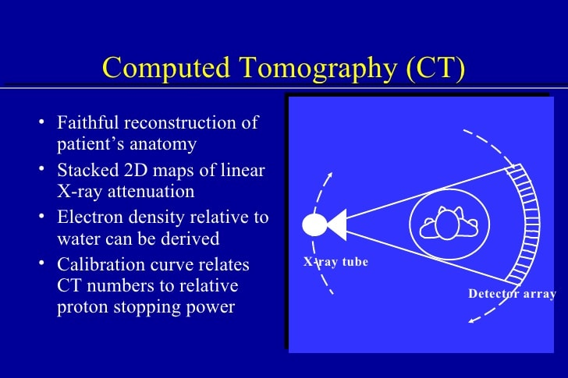
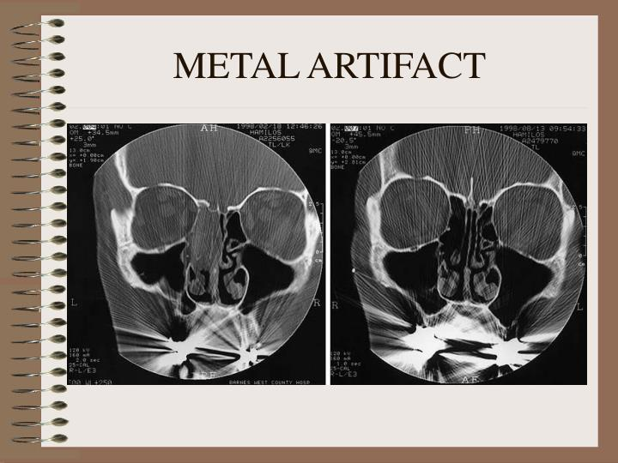
Sources of uncertainties
CT related:
Inaccurate Unit conversion
Presence of artifacts
(systematic uncertainties)
Fundamental for the
treatment planning
Sketch of a CT machine
CT of face layer, presence of metal implants in the mouth
<numero>

Slide 37
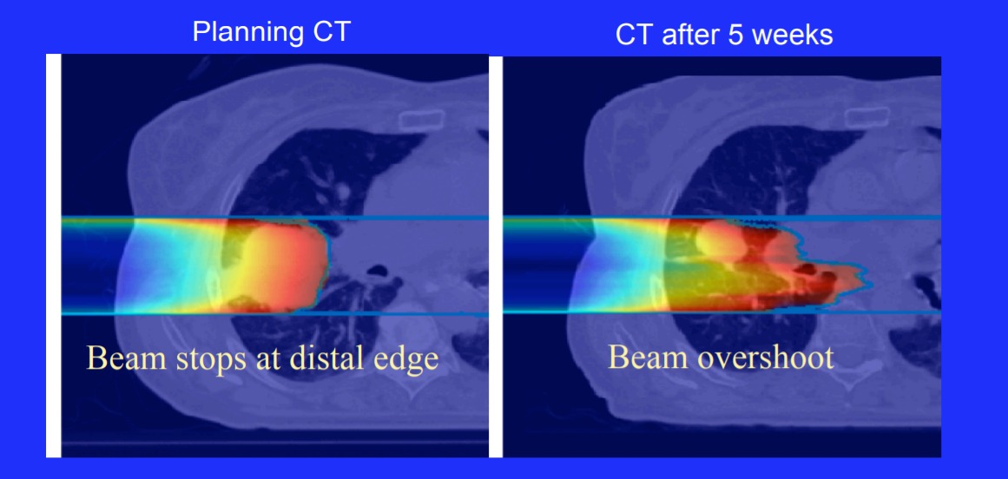
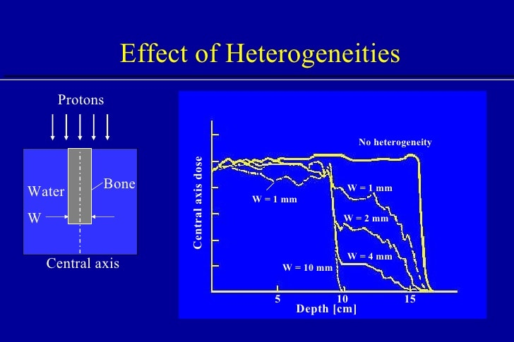
Sources of uncertainties
Patient related:
patient position
density dishomogeneities
organ motions
anatomy changes
(random/systematic uncertainties)
p
A proton beam in water crosses a material with higher density: this changes drastically the range
CT of lung, at the beginning of the treatment and after 5 weeks:
Tumor anatomy changes
<numero>

Slide 38
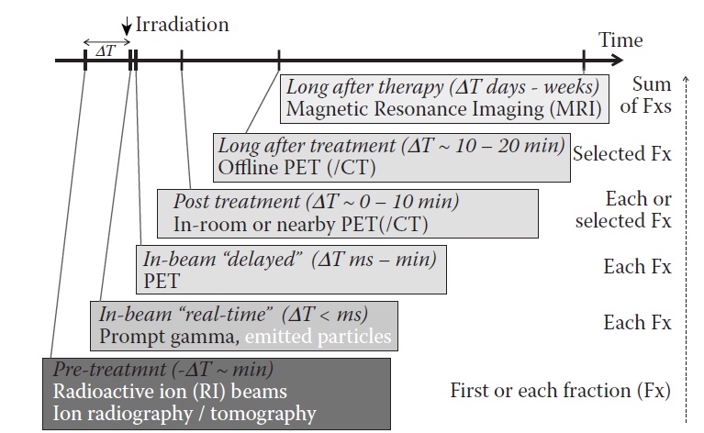
In vivo range verification
irradiation
time
After therapy MRI
After treatment In-room / Offline PET
On-time feed-back
exploit the treatment beam
Clinical tests
In - treatment PET
Prompt gamma detection
Charged particles detection
Implantable dosimeters
Pre-treatment Ion beams radiography
<numero>

Slide 39



Diagnostic vs In vivo range verification
Diagnostic PET and SPECT
In-vivo monitoring PET and SPECT machine
Exploit activity of radionuclides
Recostruction of the biological functions of organs via images / measurements
Exploit activity of secondary fragments of treatment beams
Reconstruction of the release of dose of the beam via measurements/ images
→ «teragnostic»
In the best scenario, it is possible to use the same machines
<numero>

Slide 40
PET machines
Example of diagnostic PET machine
and in-beam PET machine (the latter at GSI)
Full cyrcle vs double-head system
Higher gamma ray background
No additional dose costs for the patient
Sketch of PET working principle
<numero>

Slide 41
In-beam vs off-line PET machines
In beam:
2 head cottected to the treatment accelerator
no repositioning of the patient
on-line corrections of the treatment would be possible
It compromises patient throughput.
Low angle acceptance
Low metabolic washout
Off – line:
Full ring scanners offer a higher detection efficiency CT scanner (PET-CT) compensating for the unavoidable patient movement
Low statistics because low activity after some minutes
Higher metabolig washout
In room:
directly following treatment delivery
using the same patient immobilization and treatment couch.
<numero>

Slide 42


in-beam PET purposes
Able to detect:
range of the ions in vivo
unexpected density modifications
inaccuracies in patient positioning
Anatomical changes, their effects on dose and the approximate quantification of dose
deviations from the treatment plan.
Prediction of beta+ activity vs. in-beam PET measurement. The measurement indicated a
slight rotation of the patient counterclockwise
<numero>

Slide 43
in-beam PET constraints
Constraints:
restricted knowledge about the elemental composition metabolic washout
low resolution due to spatial limitations
Low statistics, no quantitavie measurements
High background (gamma prompt, neutrons due to passive scattering beams..)
Expencive
Further researches:
Tof, new detectors, highest graphic algoritms, highest efficiency photons, hypofractionation
treatments with higher dose delivery, improved imaging detection
<numero>

Slide 44







PGs detectors
slit gamma camera
1-D profile
slit against bkg
fast scintillator detector
dE/dx + TOF from scint
used for discrimination
Compton camera
define origin cone from CC
electron tracking Compton camera
TPC + scint
TPC: angular localization
Less CC but highest efficiency
35 s
35 s
<numero>

Slide 45

PGs vs β+ gammas
Pro:
no physiological washout
no delay detection
higher yield
reduced signal attenuation
better resolution
Needed high detection efficiency good spatial and time resolution
Cons:
much higher SNR
Full ring PET + TPC Compton camera:
new concept of Hybrid detector systems
Schematic drawing of the 3-γ imaging principle On- and off-line monitoring of ion beam treatment, Katia Parodi
<numero>

Slide 46


emission distribution properties
Detector: Single Proton interaction vertex imaging
Optimal angle detection:
Low angle
Higher kinetic energies of particles
Higher flux
Lower MS
High angle (~ 90°)
Better spatial resolution
Higher efficiency: no bkg
Spatial uncertainties due to angle emission
trade off, generally ~ 60°
C beam
300 Mev/U
H20 target
α = 30°
d = 2.2 m
Sketch of single proton IVI
(Drift chambers,
Inorganic crystals)
Particle composition:
Mainly p,d,t,
→ Seconday particle emission point reconstruction:
Primay beam direction by beam delivery system
Particle vertex direction by tracker
Back-tracking
energy vs. time of flight (expressed in nanoseconds) distributions
<numero>

